Slide 1

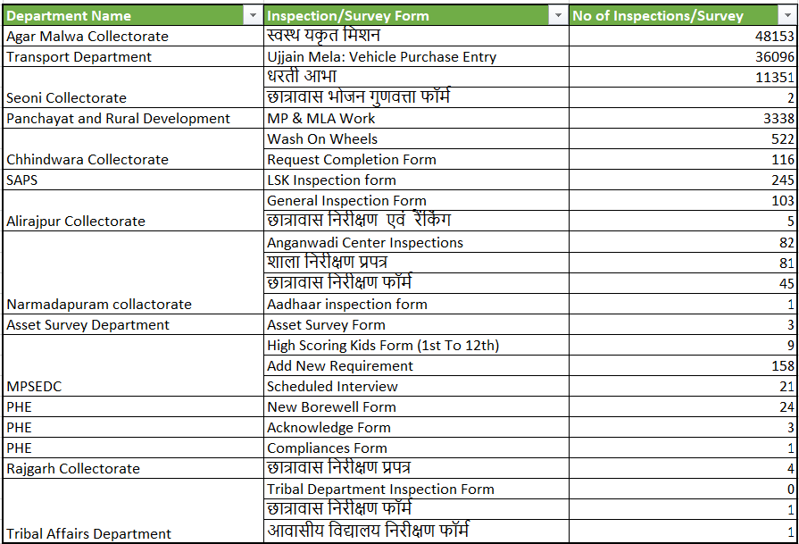
Parakh Count of Survey and Inspection
Registered Departments All Form Record Statistics & No of Inspection and Survey conducted

Slide 2
Parakh Working Modules
Agar Malwa – Swashtya Yakrit Mission. - 48 K forms submitted as of today
PNRD- MP/MLA Work assessments are going on.
Chhindwara – Wash On Wheels
Seoni – Dharti Abha – 12K forms submitted as of today.
SAPS – Lokseva Kendra Inspections – 250 inspections being conducted so far.
Key concerning projects under pipeline:
A) Labour Department – CIS and Inspection Application
B) Tribal Department – Schools and Hostel Inspections

Slide 3
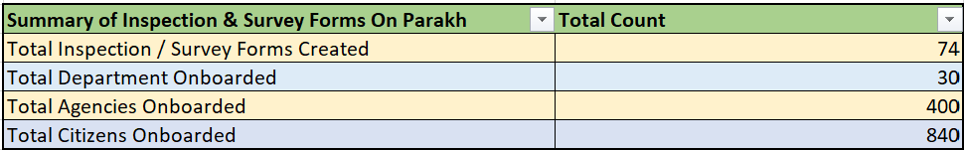
Parakh Data Usage
Summary of Inspection & Survey Forms On Parakh
Note: Above Total Inspection/Survey Form & their Count

